Slide 2
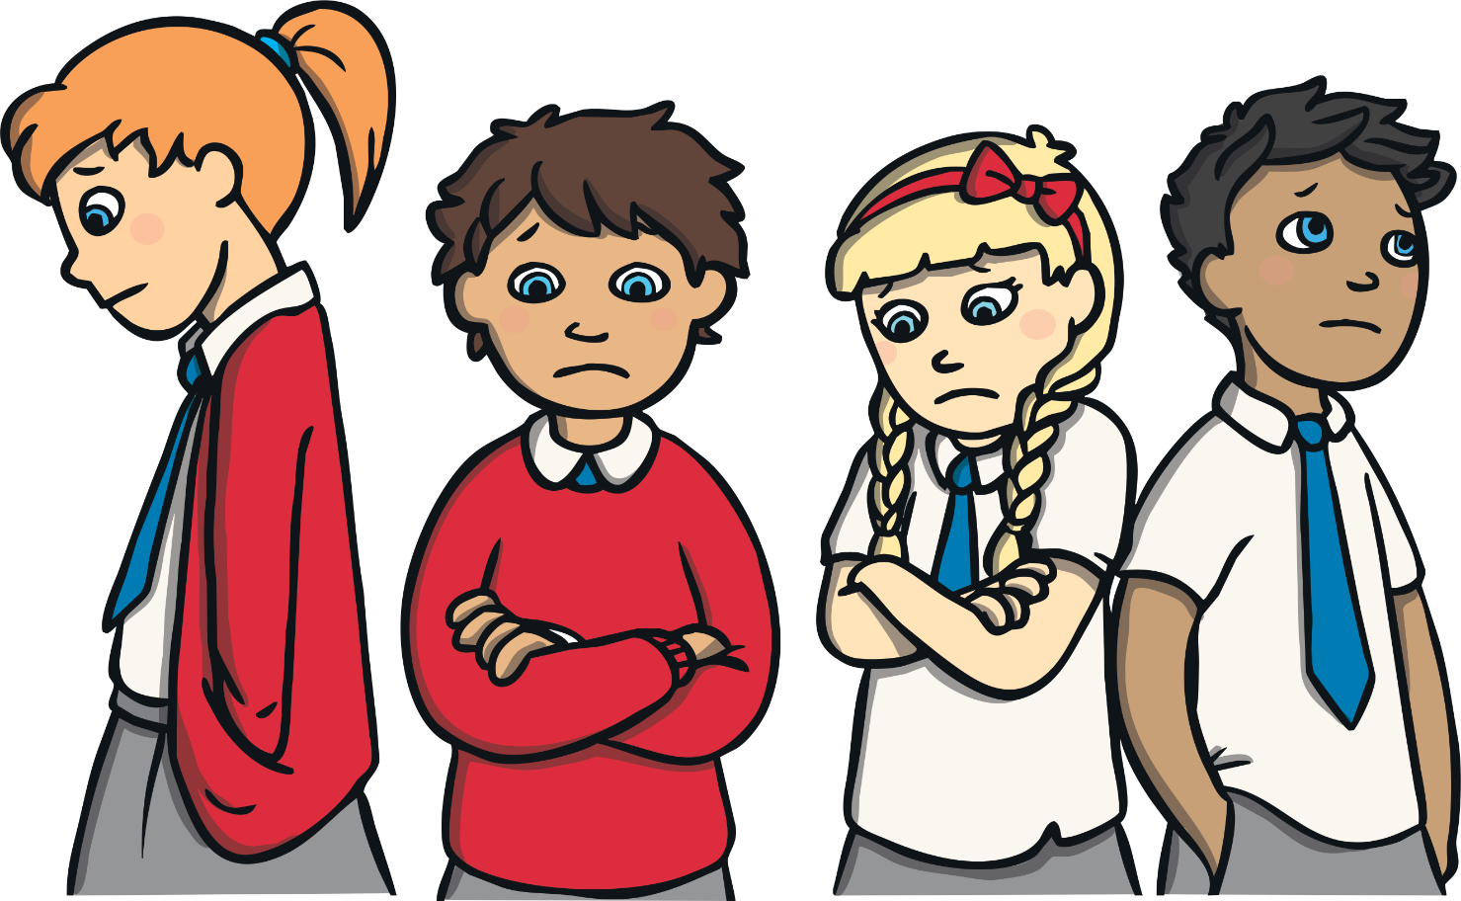
What Is Mental Health?
Mental health is about how you feel, think and sometimes behave. Lots of children have mental health issues and it means they can feel sad, angry or anxious.

Slide 3
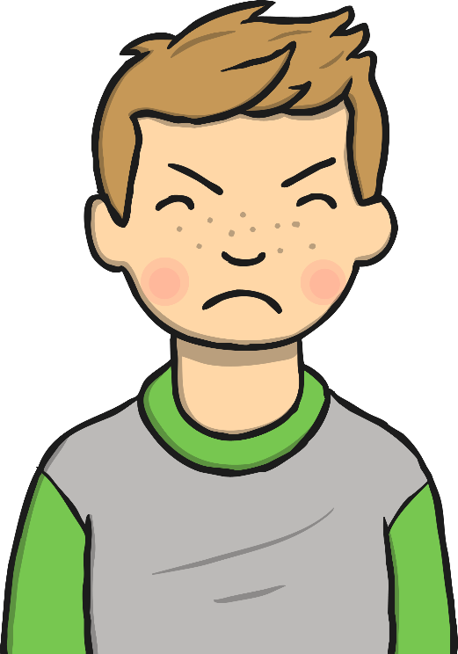
Can You Think of any Mental Health Issues?
These are some of the ways that you can feel if you have a mental health issues.
sad
anxious
angry

Slide 4
I Feel Sad
I sometimes feel like crying, being on my own or not wanting to come to school.
back

Slide 5
I Feel Anxious
When you feel anxious your heart beats fast and you might feel sweaty
and sick.
back

Slide 6
I Feel Angry
It’s normal to sometimes feel angry but sometimes it becomes too much and you feel angry all the time.
back

Slide 7
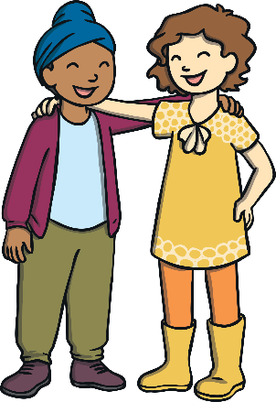
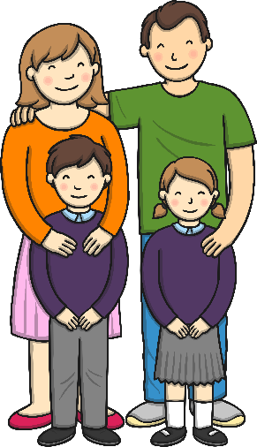
Where can I get help?
There are lots of people to help you if you feel sad, angry or anxious. Here are some of them:
family
teacher
friends
doctor
phone a friend/family member

Slide 8
Where can I get help?
ELSA
Mrs Powers

Slide 9
Where can I get help?
SENCO – Mrs Corp
Mrs Corp

Slide 10
Where can I get help?
Playground Buddies

Slide 11
Where can I get help?
Health School Reps
School Council Reps

Slide 12
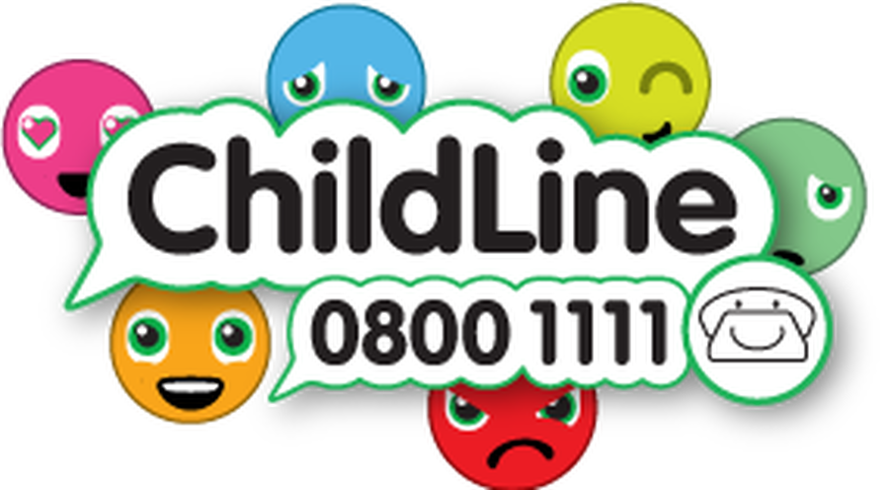
Where can I get help?
Child Line

